Slide 1
Algorithm Compendium Lucrare de dizertatie
Student: Fermus V. Vasile-Octavian
Specializare: Sisteme Distribuite
Profesor Coordonator: Asist. Dr Vasile Alaiba

Slide 2
Contents
Introduction
Used Technologies
Front-End
Back-End
Functionality
Mandatory Functionalities
Messaging System
Algorithm Search and Request
Algorithm Post
Algorithm Comment and Grading
Multi-Language Support
Report System

Slide 3
Introduction
Algorithm Compendium is an online application that wishes to gather algorithms written in a multitude of different programming languages with the help of its users.
The application, at its core will let users:
post algorithms
grade algorithms
comment on exact lines of a given algorithm in order to provide feedback
request algorithms
create groups and talk through private messages
search for algorithms based on popularity, name and/or programming language

Slide 4
Used Technologies – Back-End
What will I use?
MySQL
MySQL will be use to store data in databases, different for users, posts, comments and notifications.
Persistence
PHP (Laravel 5)
Laravel 5 will be used as the framework for the Back-End Implementation, dealing with server calls through API-s, and providing a consistent session implementation and ease of use
Session Management
Templating Engine
Ease of use
More to come
As project development will continue, libraries and plugins might be added in order to facilitate it. At the moment, on the possible list of libraries I only have Upload (for image uploads).

Slide 5
Used Technologies – Front-End
What will I use?
Blade Templating Engine
Blade is a templating engine provided by Laravel. Making use of sections and template inheritance, duplicate code in pages is removed, simply by inserting a section that is only written once in a different file. If that file is modified, the modification will be seen across all the pages using the section. This will help us with the GUI
Ease of use
Removing duplicate content
Lightweight code
SASS
SASS will be used for stylizing the pages, providing a better form of CSS, allowing clean code, variables and other beneficial chances to the classic CSS
Page stylization
The use of variables in CSS
Mixins

Slide 6
Used Technologies – Front-End
What will I use?
Javascript (jQuery)
Javascript will be the scripting language, using jQuery as the main library for HTML manipulation, event handling, cross browser compatibility and AJAX calls. Most requests to the server will be made with Ajax Calls to facilitate user experience.
Other used libraries will be:
jQuery UI – to provide different UI elements which would take considerable time to develop by hand such as draggable elements or autocomplete
Ace Editor – to provide a customizable text area for code writing and reading, with programming language support

Slide 7
Used Technologies – Front-End
What will I use?
Bootstrap
Bootstrap is a framework used to develop responsive online applications, offering, among others, grid support and basic stylization. Most stylization will be developed from scratch, but the grid support is invaluable.
Grunt
Grunt will be used to minify SCSS and JS through provided libraries and uglify the code, reducing its size
HTML 5
HTML5 will be used for the structure of the pages, along with Blade Templating.

Slide 8
Functionalities
Mandatory functionalities
Register/Login
Register and Login forms will be provided on a single page, server requests for both functions will be done with AJAX calls. The possibility of registering an account using Facebook or Google Plus is being taken into consideration.
Forgotten Password
Forgotten Password function will be on the same page as the previous two, sending the user an email in order to change it if he provides a correct email address
Session Support
Session Support will be provided by Laravel, along with creating a hash of the password instead of storing it in its clean form.
Profile Page
Users will be provided with profile pages with editable information; People can also comment on the user’s page and upvote the user if they so desire

Slide 9
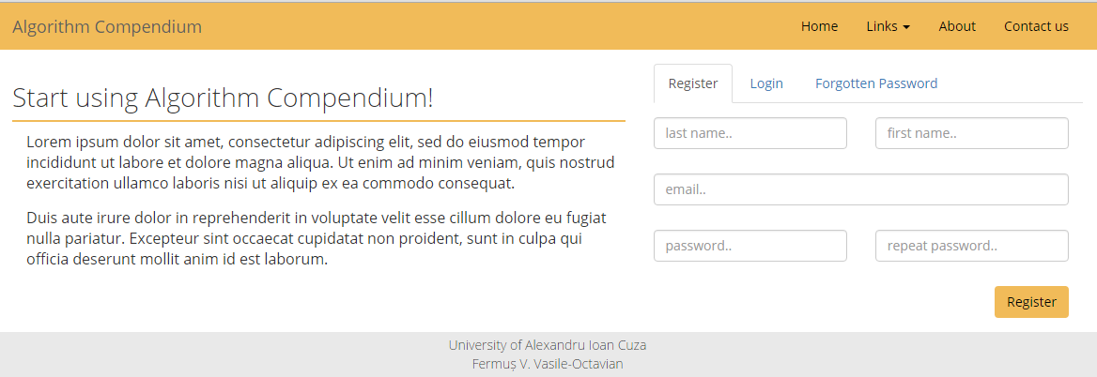
Landing Page mock-up

Slide 10
Functionalities
Messaging System
Any user will have a notification tab, which will have three main sections:
Algorithms
Here, the user will be notified of algorithm comments, either on his own algorithms or replies on comments made by the user
Conversations
This section functions as a inbox/outbox, in a two-way communications between only two persons, alike an email system between users in the application
Groups
Similar to the ‘Conversations’ section, this tab provides support for group pages which will be able to display links, text and images seen by all group members. Anyone can create groups and add members to it and of course, leave the group.

Slide 11
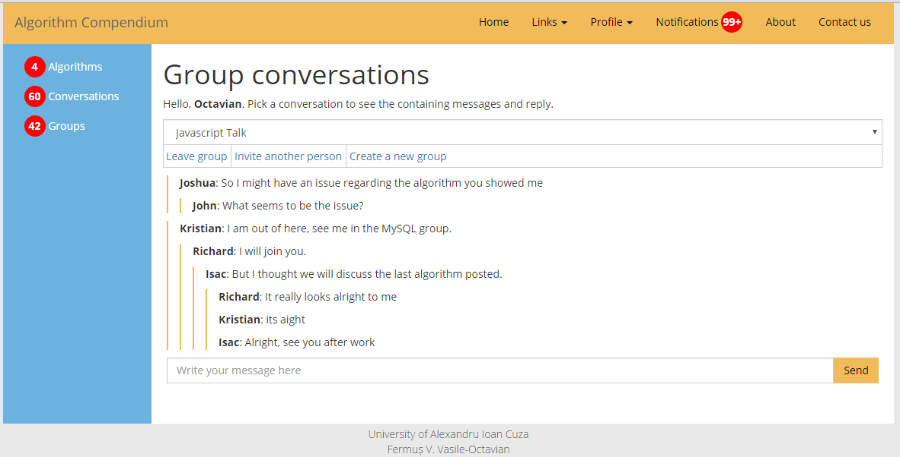
Notifications page mock-up

Slide 12
Functionalities
Algorithm Search and Request
In the main page, any logged user can search algorithms based on keywords and/or programming language.
In his search, a user can choose to be provided only popular algorithms or ones with a positive upvote/downvote ratio.
A user can also request an algorithm if he cannot find what he looks for, being notified when someone creates it.
Users will also be able to favorite algorithms to have them in a list for easy and fast viewing later on. Any saved algorithms will still be deleted if the creator wishes so, and any user that saved it will be notified.
The results can be viewed either in table form or in a simple list form, based on user preference.

Slide 13
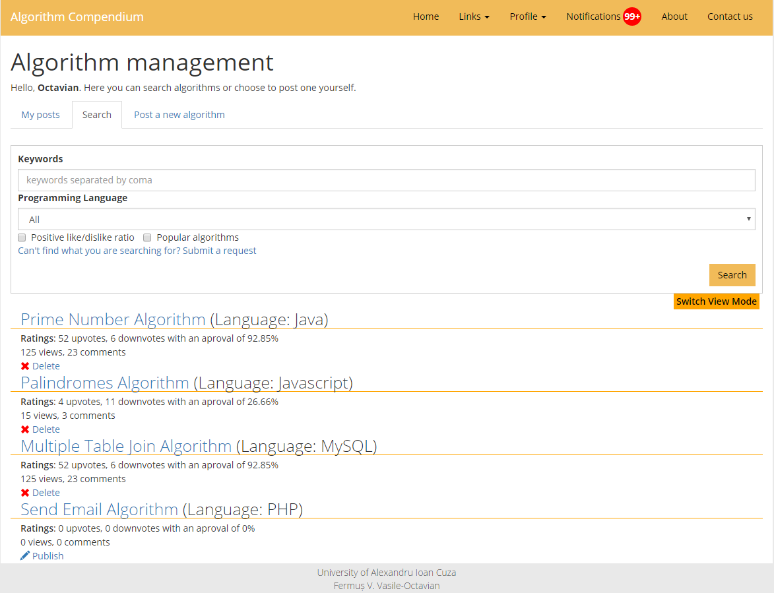
Algorithm search page mock-up

Slide 14
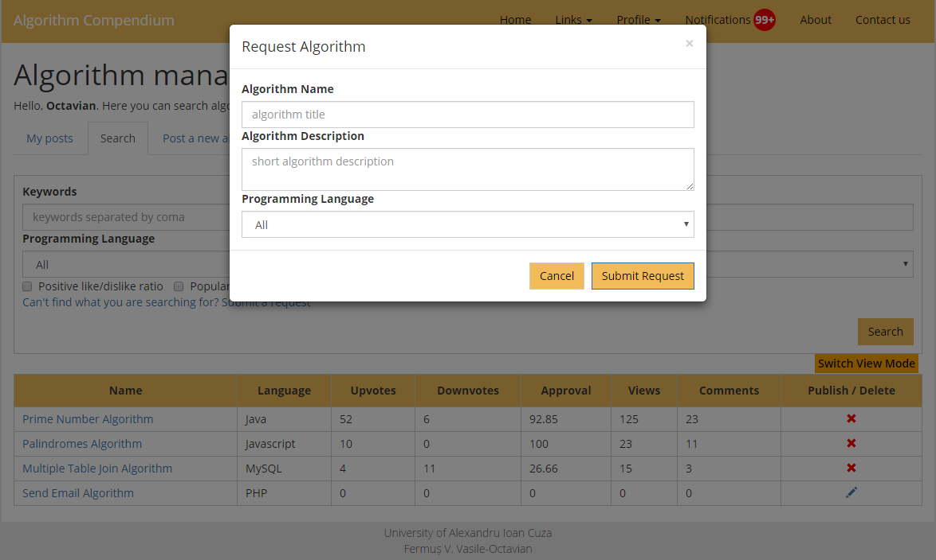
Algorithm request modal mock-up

Slide 15
Functionalities
Algorithm Post
The user is prompted for a algorithm name, short description, programming language and an optional source link, then he can click ‘Continue’ to start writing the algorithm in a text area created with the Ace Editor plugin with support for the picked language (if the language is available).
The user can choose to publish the post (without the option of editing it after publishing) or saving it for later use, in which case it can be edited.
The creator will have a special tab on the home page where he can see his algorithms, being able do delete or publish them.

Slide 16
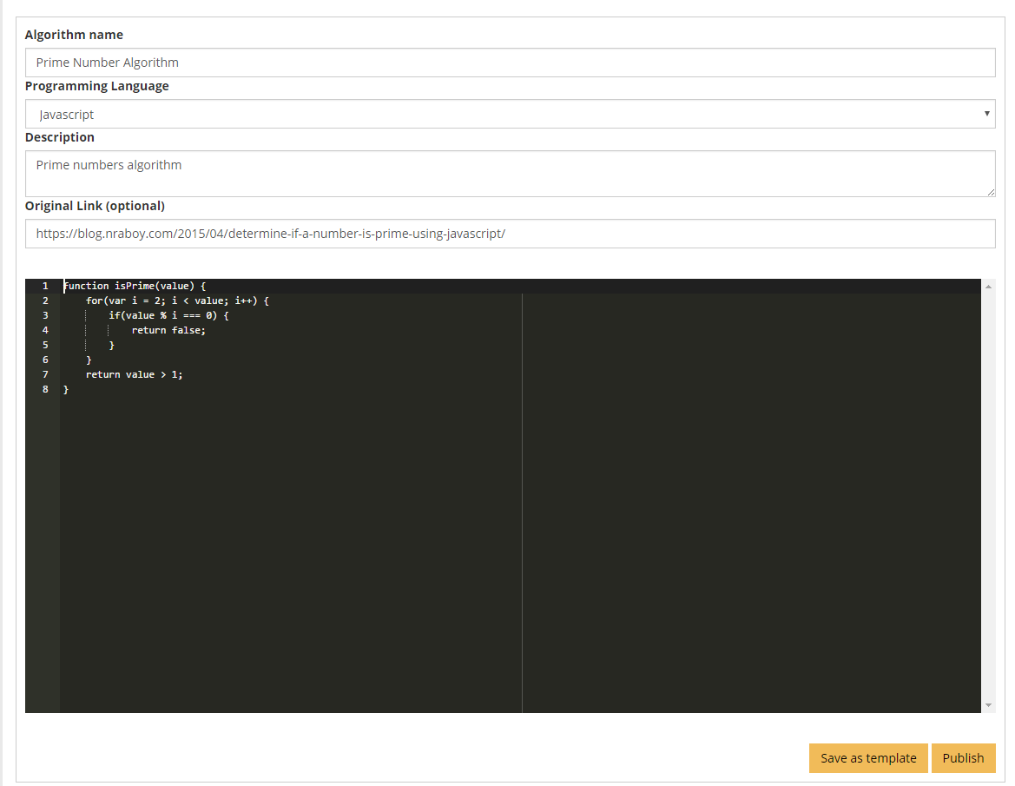
Algorithm post mock-up

Slide 17
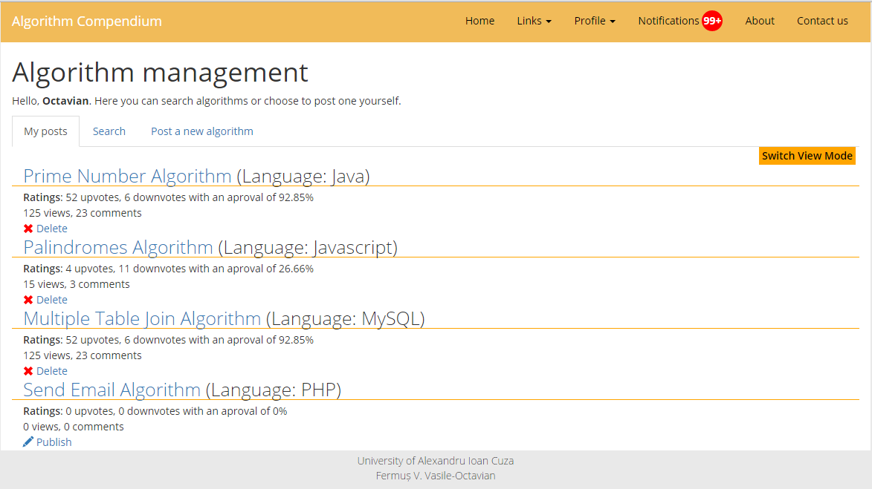
User written algorithms mock-up

Slide 18
Functionalities
Algorithm Comment and Grading
Users can comment on the algorithm as a whole, but can choose to comment exact lines of the algorithm by clicking on the Ace Editor Sidebar.
By doing so, they can see other comments made at that exact line and add their own if needed be. The Popup Line Section popup is draggable and resizable.
In the up right corner, the user can choose to upvote/downvote or report the algorithm.

Slide 19
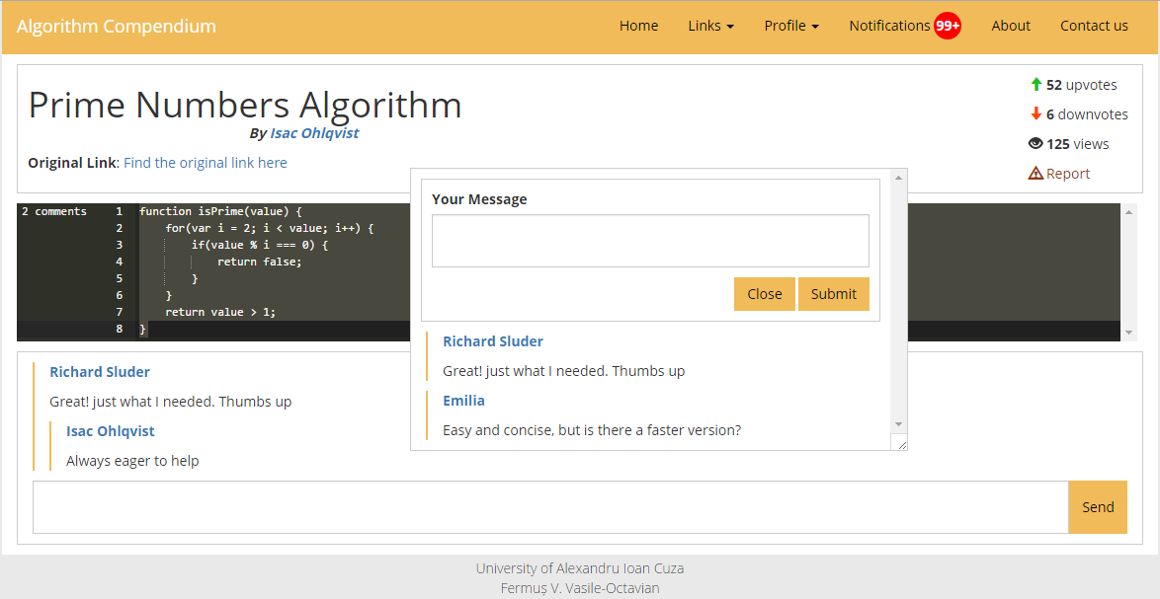
Algorithm comment mock-up

Slide 20
Functionalities
Multilanguage support
As a starting point, the application will be created using the English language, but if time allows it I would like to implement Romanian language support using Ajax to get the data needed for the changed text and cookies to save preference.
If the user chooses one of the languages wanted in the profile section, that language will be taken as default, otherwise English will be used if no cookie is found.

Slide 21
Functionalities
Report System
Algorithms and users can be reported for various reasons
Measures will be taken, either upon the user that reported the page/user if the claim is false and considered as abuse or the user that was reported if the claim is valid.
Measures can vary from warnings to algorithm/comment deletion and bans.

Slide 22
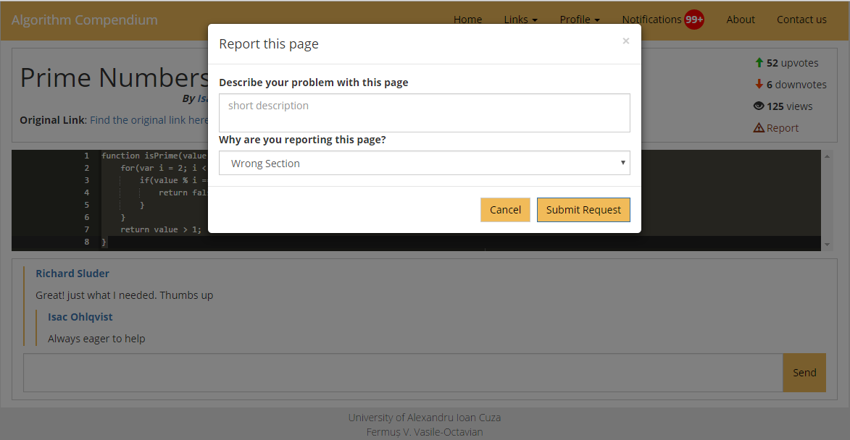
Report modal mock-up

